Slide 1
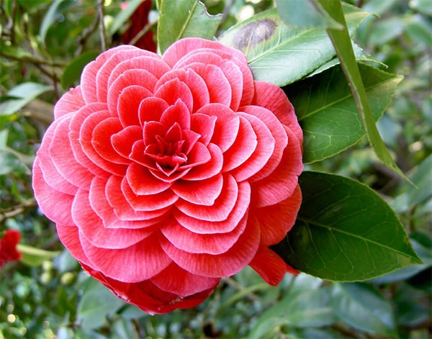
به نام خالق گل

Slide 2


Slide 3
حاصلخیزی خاک و تغذیه گیاهی در فضای سبز شهری
سطح 2 و3 هرم آموزش منابع انسانی
سازمان پارکها و فضای سبز شیراز

Slide 4
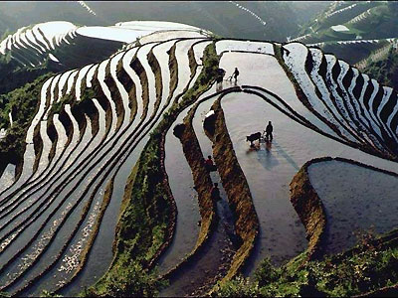

Slide 5
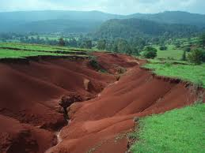

Slide 6
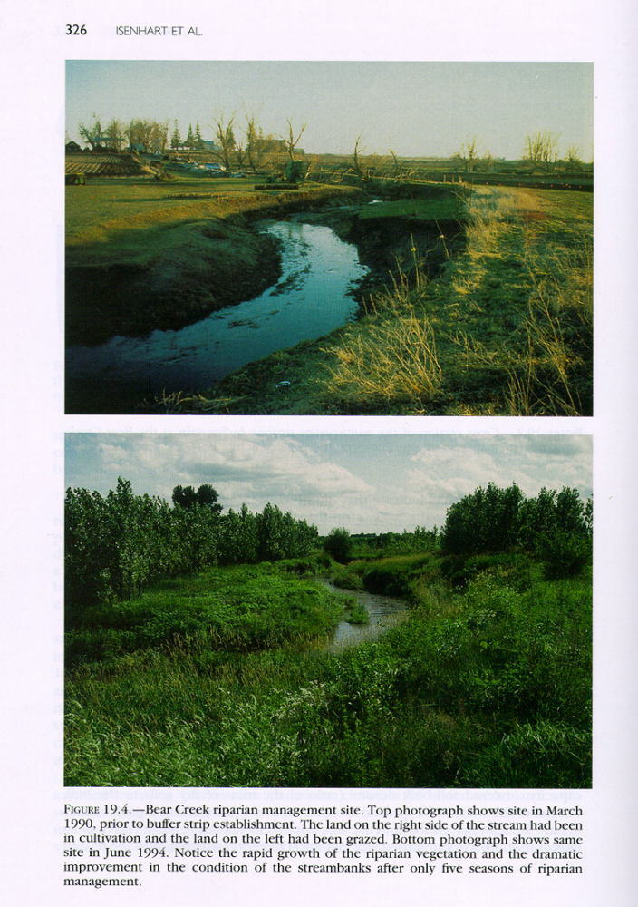

Global issues
fertility
erosion
irrigation
forestry destruction

Slide 7
NPK consumption, kg/ha
IFA, 2001

Slide 8
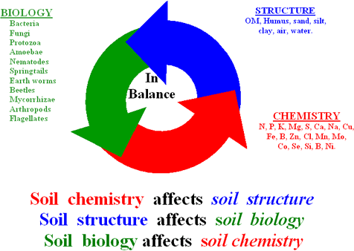

Slide 9
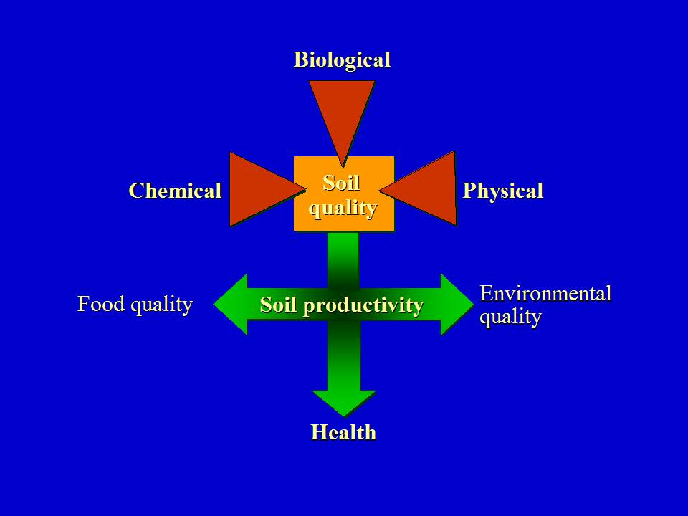

Slide 10
Organic fertility management
Organic fertility management is much more than adding nutrients into the soil.
Overall goal is to balance nutrient inputs and outputs and ensure a good balance of nutrients for the crop
to achieve this requires a complex mix of soil management activities including tillage, irrigation, residue management, weed management and crop rotation planning
Neglecting any of these components can compromise crop performance.

Slide 11
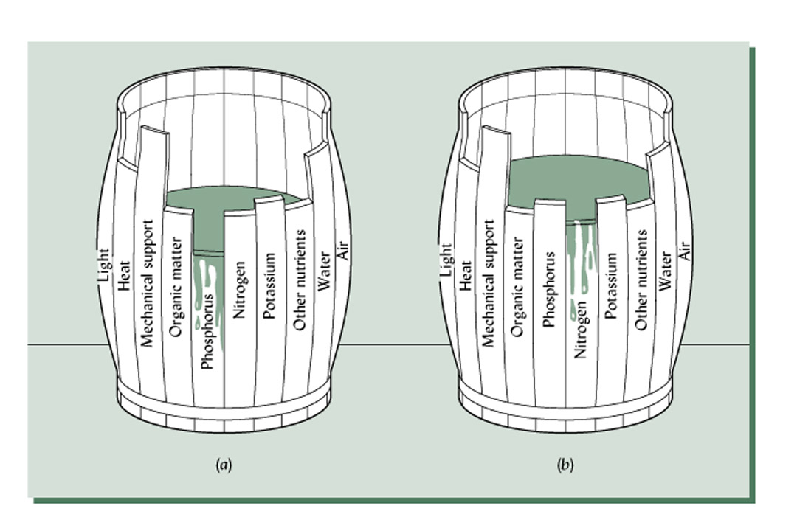
The Barrel

Slide 12
“Law of the Minimum”
Crop yield is limited by the most limiting factor. When that factor is removed, yield is limited by the 2nd most limiting factor, and so on.
Barrel metaphor

Slide 13
خاک حاصل خیز چیست
خاک حاصل خیز:
تامین کننده بستر مناسب برای جوانه زنی بذر
امکان رشد و توسعه ریشه گیاه را فراهم آورد.
تامین کننده مواد غذایی به میزان کافی برای تکمیل چرخه زندگی گیاه
حمایت از استقرار فیزیکی گیاه را انجام دهد.

Slide 14
ویژگی های عمومی یک خاک حاصلخیز
حاوی مقادیر کافی عناصر غذایی ضروری برای تغذیه گیاهان شامل نیتروژن، فسفر و پتاسیم باشد.
حاوی مقادیر کافی عناصر کم مصرف (ریز مغذی ها) شامل؛ کبالت، مس،روی، کلر،آهن، منگنز، منیزیم، مولیبدن، گوگرد و کلسیم و ... باشد.
حاوی مقادیر مناسب ماده آلی که برای بهبود ساختمان و حفظ رطوبت خاک مفید است باشد.
دارای pH بین 6.8-6 باشد (اما برخی گیاهان مقادیر کمتر یا بیشتر را ترجیح می دهند).
دارای ساختمان خوب با قدرت تهویه و زهکشی مناسب باشد.
دارای جمعیت مناسب و متنوع از موجودات خاکزی باشد.
دارای ضخامت مناسب از خاک سطحی باشد.
دارای CEC بالا باشد.

Slide 15
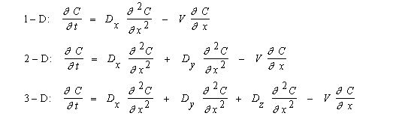

Slide 16
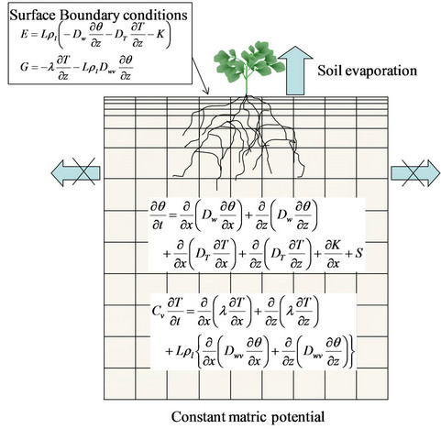

Slide 17
Nutrient Management
Soil Fertility is often concerned with the problem of managing nutrients to be applied to plants.
Three general considerations:
  Agronomic (how much is needed)
  Economic (how can profit be maximized)
  Environmental (minimize pollution)

Slide 18
B: The input was needed
A: The input was not needed
C: Another factor limited
growth

Slide 19


Slide 20
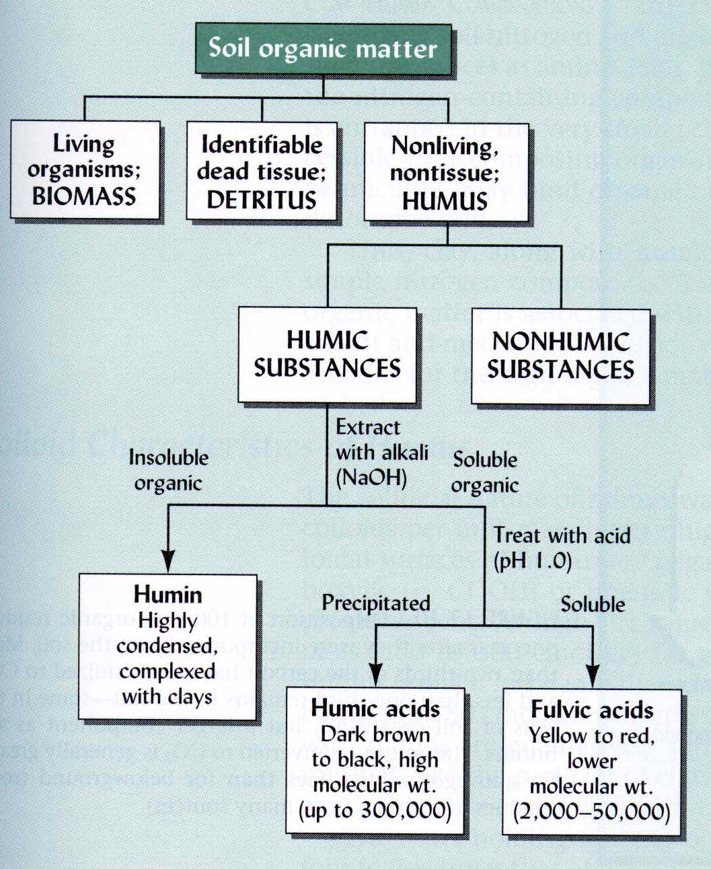
Constituents of Soil Organic Matter
Source: Brady and Weil, 1996

Slide 21
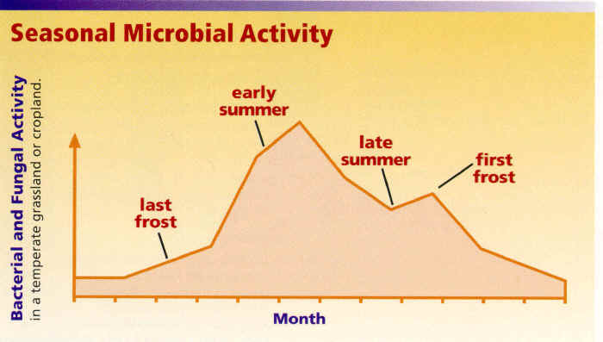

Slide 22
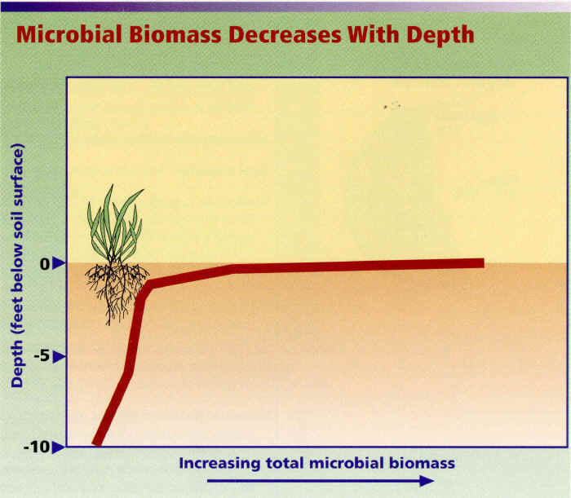

Slide 23
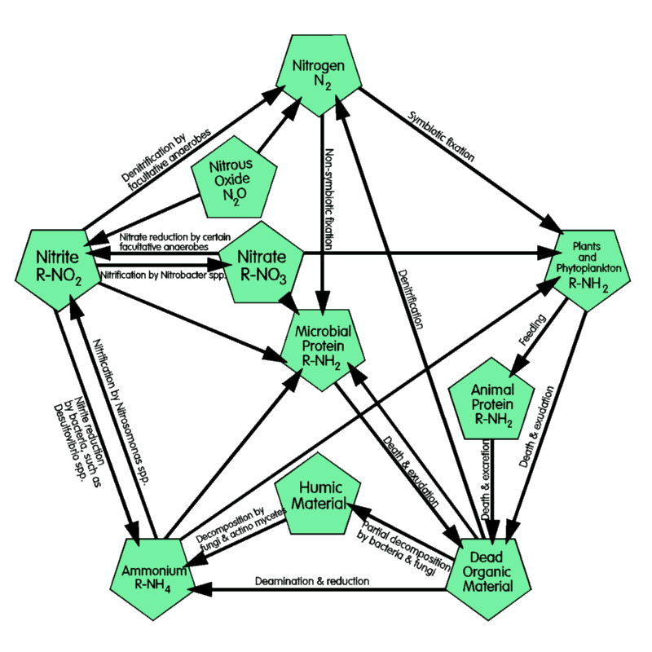
Microbes rule!!!!!!

Slide 24
Plant macro-nutrients
C, H, O Basic constituents of organic material
N Proteins, chlorophyll, enzymes etc
Ca Cell walls , cellular signals
P Energy transfer - ATP etc
Mg Chlorophyll, enzymes, protein synthesis
S Proteins
Cl Light reaction, ionic balance, stomatal movements
K Ionic balance, osmosis, enzyme activator
Micronutrients – Zn, Mo, B, Mn, Cu

Slide 25
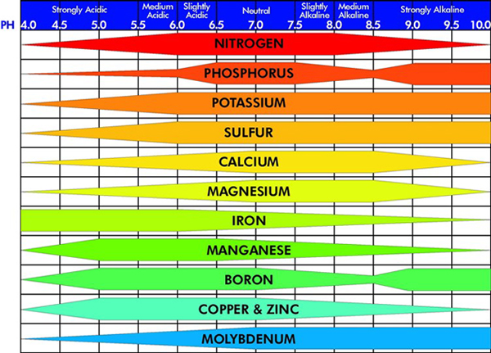

Slide 26
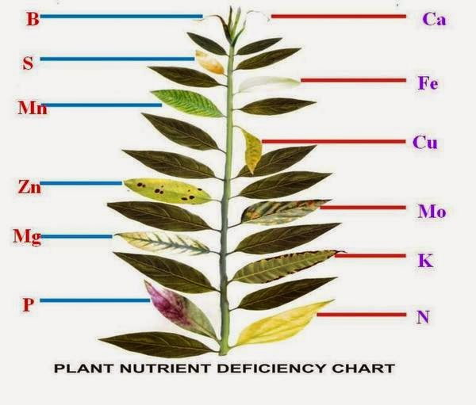

Slide 27
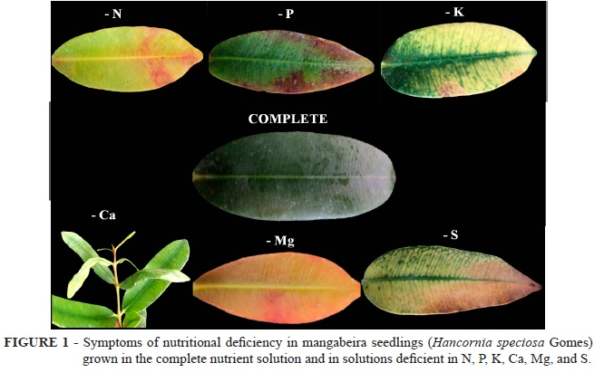

Slide 28
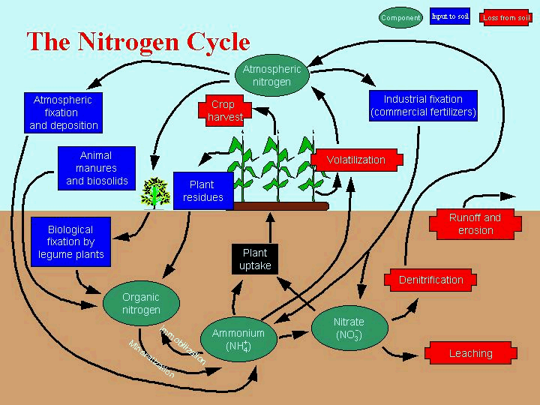
COMPONENT
INPUT
LOSS
Lightning, pollution

Slide 29
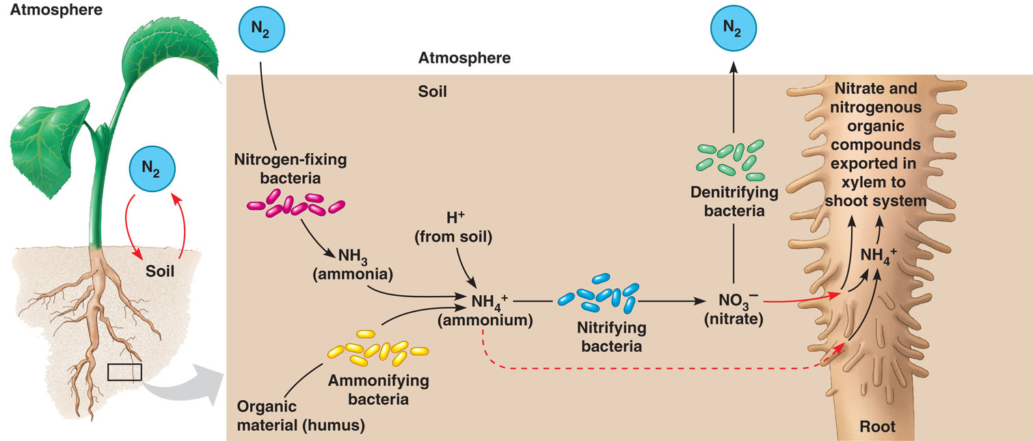
Nitrogen Uptake
Nitrates
  plants can only take up nitrate (NO₃⁻)
Nitrogen cycle by bacteria
  trace path of nitrogen fixation!
root
What will the plant use N for?

Slide 30
Nitrogen cycle characteristics
Inputs:
  fertilizer
  manures & other organic materials
  N₂ fixation
  atmospheric deposition
Main stores:
  atmosphere N₂ gas
  soil OM (>90% soil N)
Outputs/losses
  crop harvest
  denitrification
  leaching
  erosion
  volatilization

Slide 31
What controls net mineralization of N
Balance of mineralization vs immobilization
  C:N ratio
      microbes need about 25x as much C as N to grow
      If C:N ratio of organic amendment is <20-25, then excess N is released, ---mineralization>immobilization
      If C:N ratio is around 25, then
      ---mineralization = immobilization
      If C:N ratio is >25 then N limits growth so microbes scavenge nitrogen --- mineralization<immobilization
  Presence of resistant or inhibitory compounds slows mineralization
      Lignin, polyphenols etc.

Slide 32
Key microbial processes & N transformations
Mineralization:
  organic N ➔ inorganic N
  (many forms) (ammonium, NH₄⁺)
Immobilization:
  inorganic N ➔ Organic N
  (ammonium, NH₄⁺) (many forms)
  (nitrate NO₃⁻)
Nitrification:
  ammonium ➔ nitrite ➔ nitrate
Denitrification:
  nitrate ➔ gaseous forms - nitrogen oxides and N₂ gas
Ammonia volatization:
  ammonium, NH₄⁺ ➔ ammonia gas NH₃
N₂ - Fixation:
  Conversion of N₂ gas into organic forms of N

Slide 33
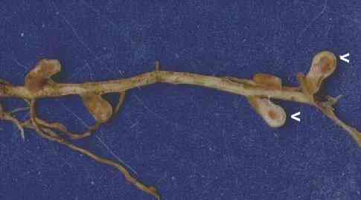
Root nodules on clover root
N₂ fixation:
  organisms in symbiotic relationships e.g. rhizobium and legumes,
  frankia and coeanothus, alder
  free living organisms
  N₂ ➔ NH₄⁺

Slide 34
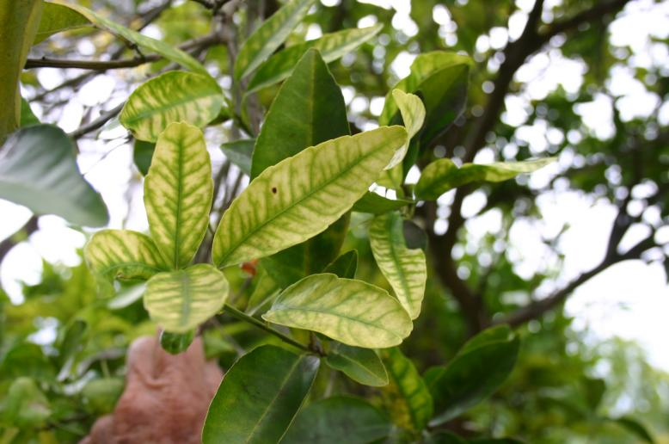

Slide 35
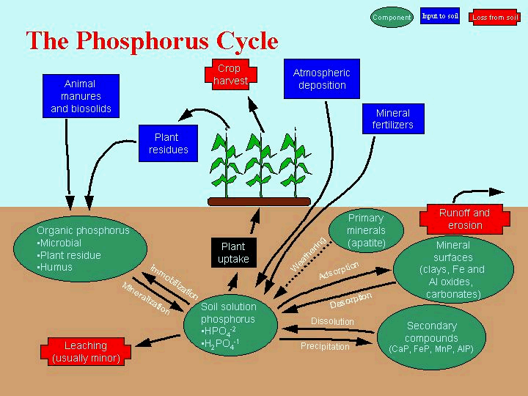
COMPONENT
INPUT
LOSS

Slide 36
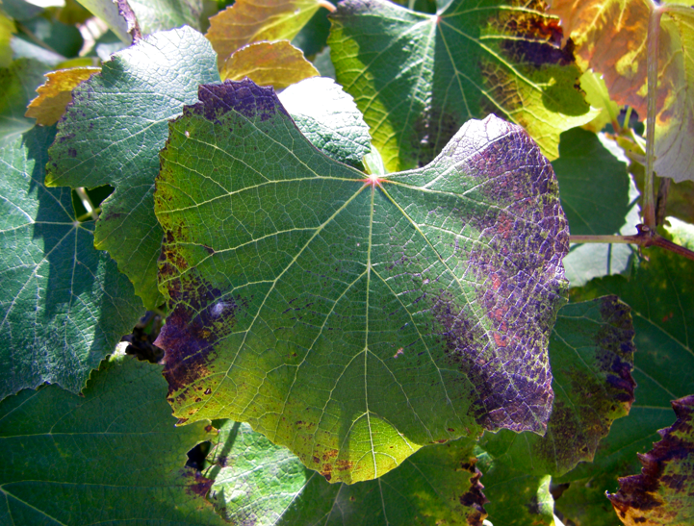
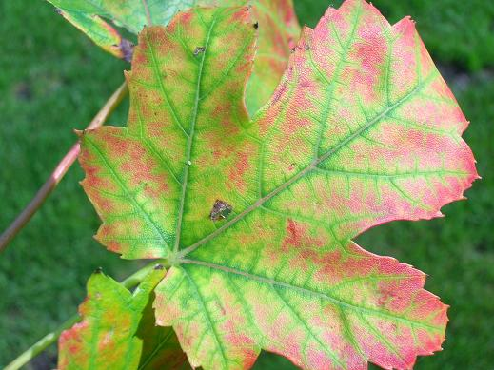
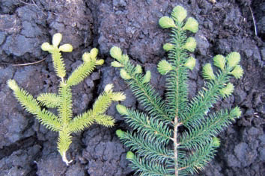
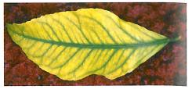

Slide 37
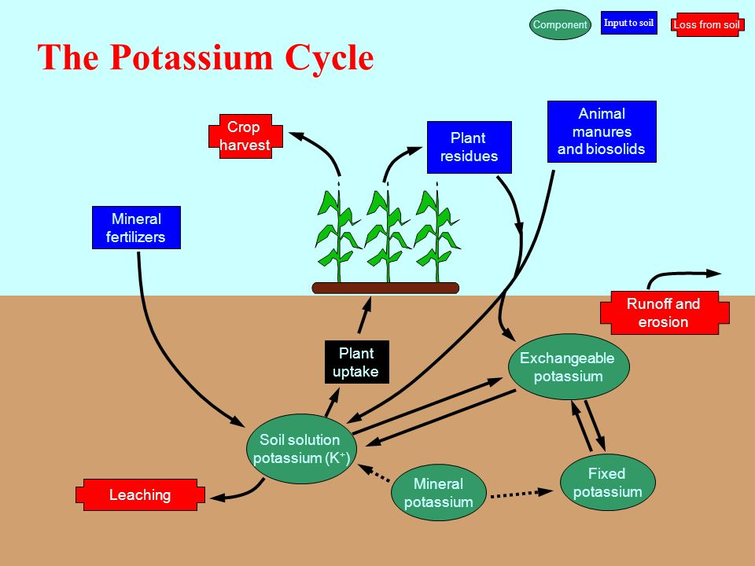

Slide 38
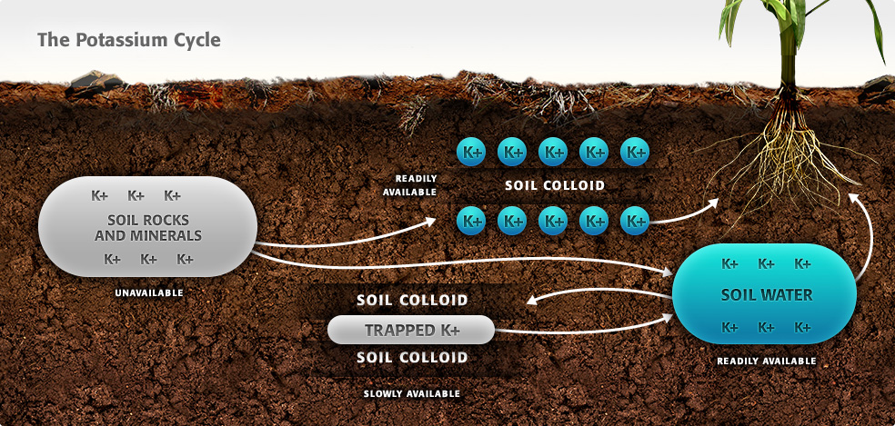

Slide 39
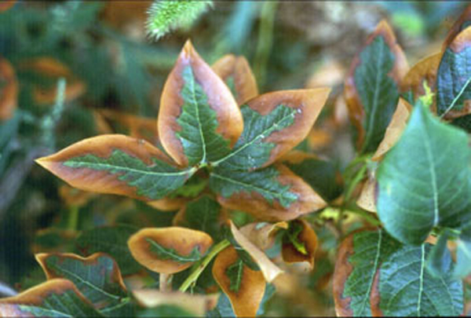
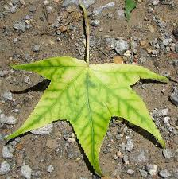
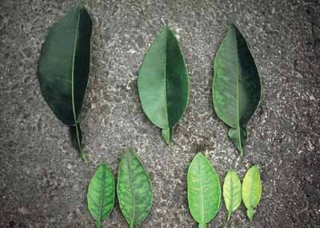
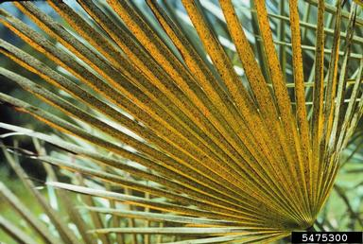

Slide 40


Slide 41


Slide 52
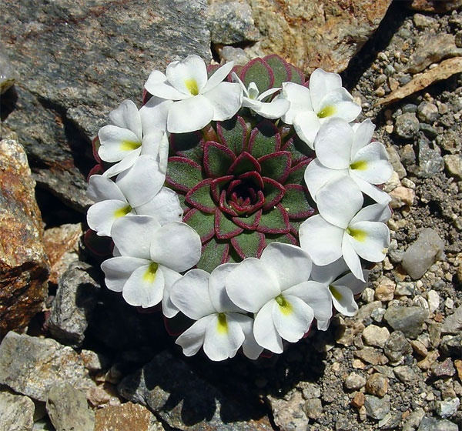

Slide 53


